Slide 1

Presented by Lutfi Rahman Hakim
Restaurant API Design

Slide 2
Background
Difficult to manage visitor
Collecting data is still done using paper Dificult to manage visitor
Difficult to calculate the stock of food

Slide 3
Solution
Create API Restaurant
Data Security
Visitor Management
Stock Management
Data security will be more guaranteed because the data will be stored on the server
With table data, it will be easier to identify tables that can be used or not
With the data stock from the food , of course, it will facilitate stock management

Slide 4

API RESTAURANT :
Authorization
Menu
Employes
Customer
Table
Detail Sales
Sales
Report Sales

Slide 5

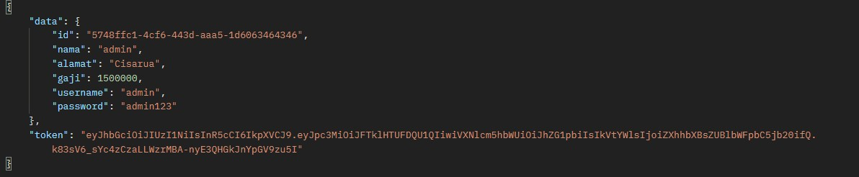
https://api-warung-makan.herokuapp.com End point Authorization
Login
Request
Response

Slide 6
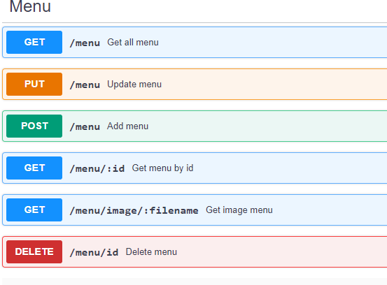
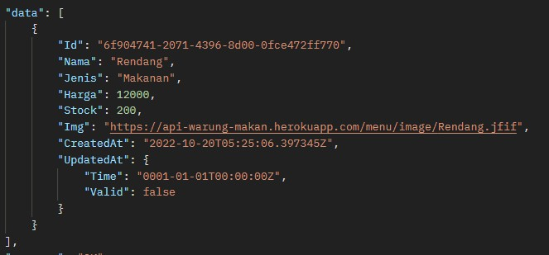
https://api-warung-makan.herokuapp.com
End point Menu

Slide 7
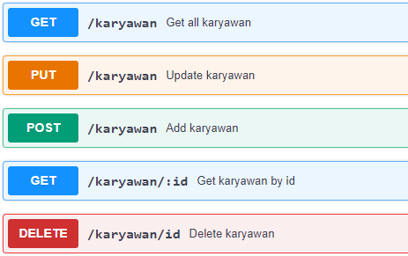
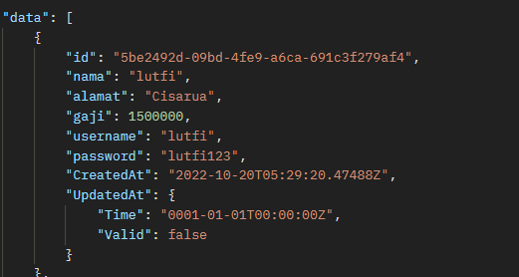
https://api-warung-makan.herokuapp.com End point Employes

Slide 8
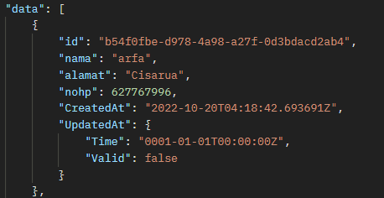
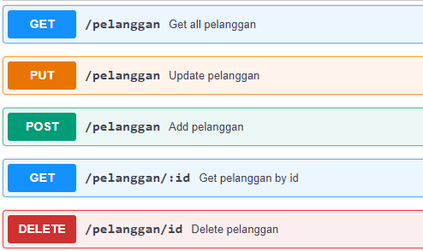
https://api-warung-makan.herokuapp.com
End point Customers

Slide 9
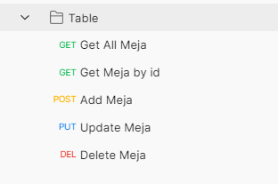
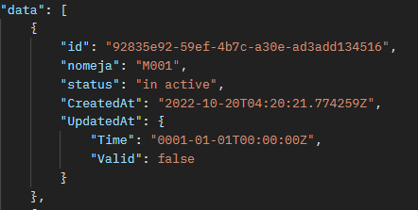
https://api-warung-makan.herokuapp.com End point Table
Table = (/meja)

Slide 10
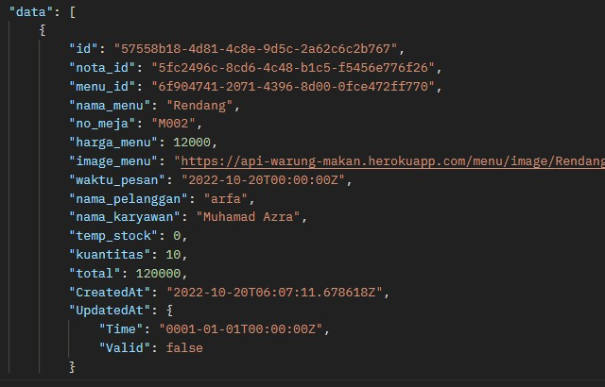
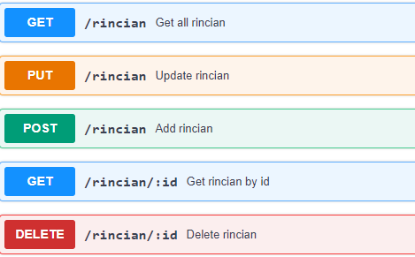
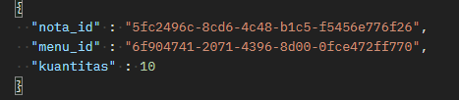
https://api-warung-makan.herokuapp.com End point Detail Sales
Post Data

Slide 11
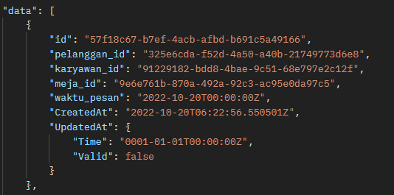
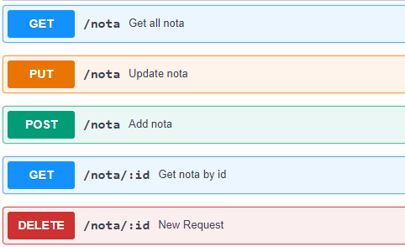
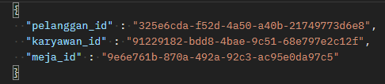
https://api-warung-makan.herokuapp.com End point Sales
Post Data

Slide 12
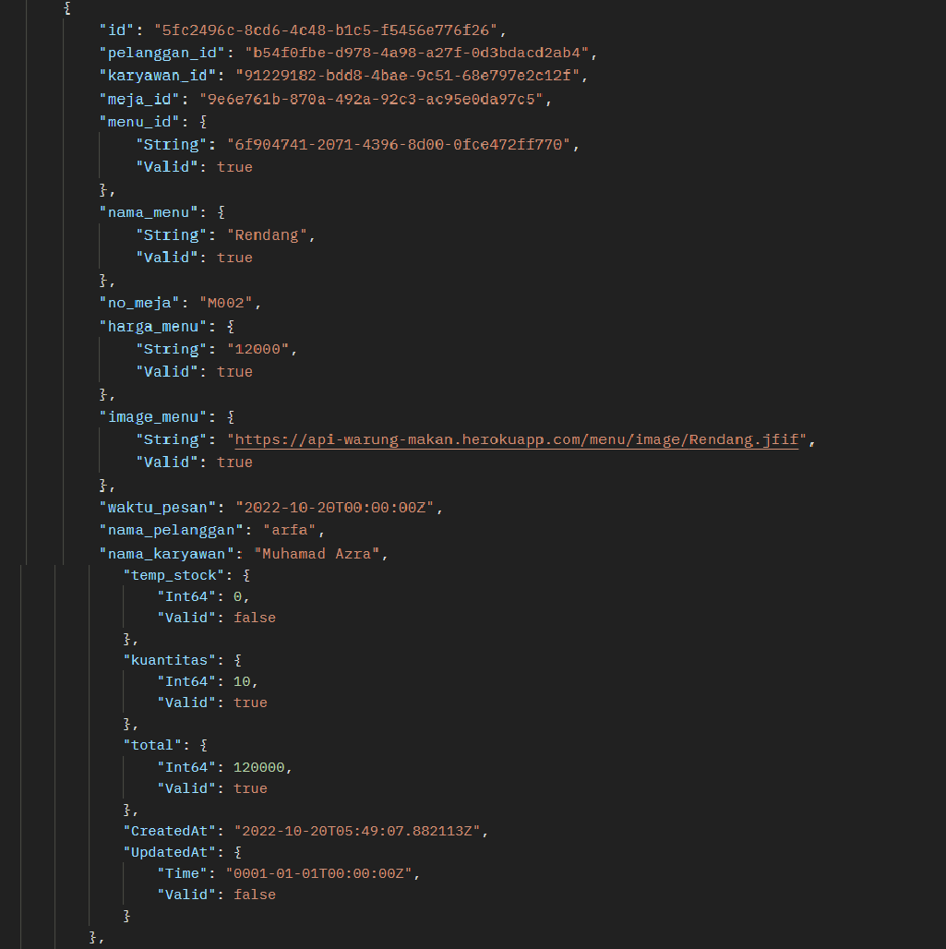
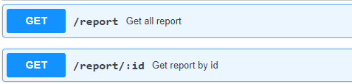
End point Report Sales
https://api-warung-makan.herokuapp.com

Slide 13
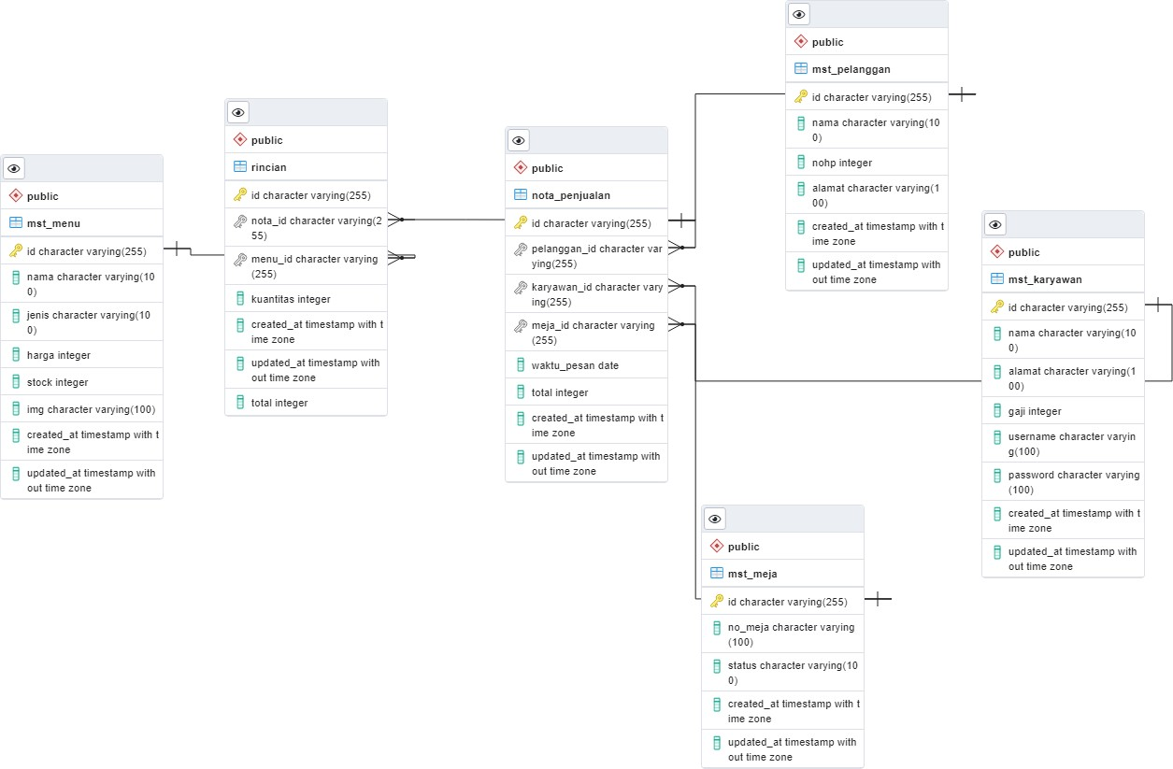
Schema Database API Restaurant

Slide 14
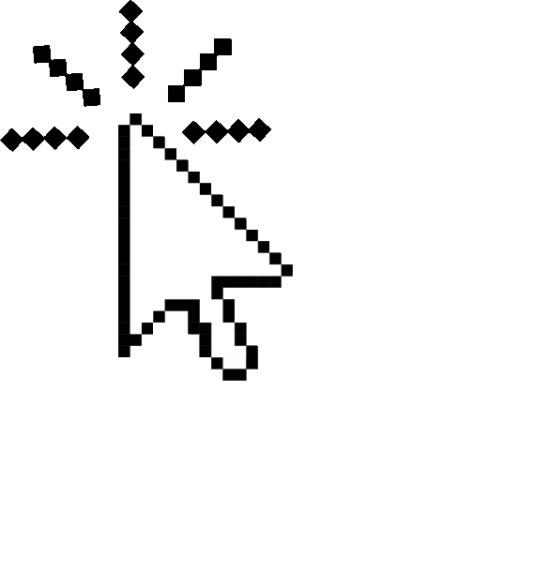
Documentacion API Restaurant
https://app.swaggerhub.com/apis/LUTFIRAHMAN400/api-warung-makan/1.0.0

Slide 15

Thank You

